Slide 1
Class Activation Map
Visualization of CNN

Slide 2
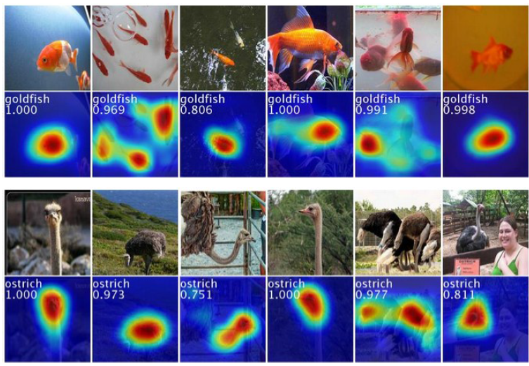
Class Activation Map – Weakly Supervised Learning

Slide 3
Class activation map (CAM)
Identify important image regions by projecting back the weights of output layer to convolutional feature maps.
CAMs can be generated for each class in single image.
Regions for each categories are different in given image.
palace, dome, church …

Slide 4
Results
CAM on top 5 predictions on an image
CAM for one object class in images

Slide 5
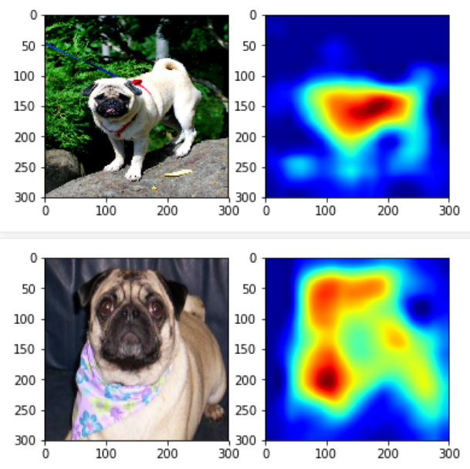
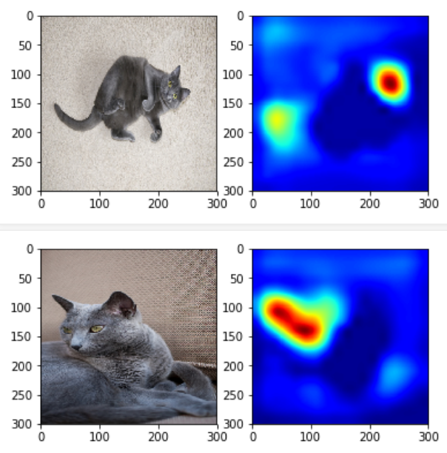
Weakness of CAM (Weakly Supervised Localicztion)
Focusing on discriminative features

